Slide 1


www.globalbigdataconference.com
Twitter : @bigdataconf
#GAIC

Slide 2

Intro to DS and ML in Python
Paul Conway & Nirav Shah

Slide 3
Introductions
Paul
Nirav
Everyone else

Slide 4
Google Colaboratory
This workshop will use Google Colab to run notebooks for code demonstrations and exercises
Slides and the notebooks for the workshop can be found at https://github.com/paulc00/ML-Intro
In the README for that repository, you can click wherever you see it to open the corresponding notebook in Google Colab.

Slide 5




Artificial Intelligence (AI) & Machine Learning (ML)

Slide 6

Introduction to Machine Learning (ML)
ML is one of the branch/subfield of Artificial Intelligence (AI)
It is the construction and study of systems which can learn from data.
It identifies pattern and relations from data and make decisions with minimum human intervention.
Applications of ML:
Market Basket Analysis
Credit scoring, Fraud Detection
Spam email detections
Chatbots
Notes:
Fundamentally, machine learning involves building mathematical models to help understand data. "Learning" enters the fray when we give these models tunable parameters that can be adapted to observed data; in this way the program can be considered to be "learning" from the data. Once these models have been fit to previously seen data, they can be used to predict and understand aspects of newly observed data.

Slide 7

Introduction to Machine Learning
Notes:
Machine Learning methods:
Supervised Learning - Eg. Classification, Regression
Random Forest
Gradient Boosting
Support Vector Machines

Slide 8
Supervised Learning:
’Teach the model’
Trained on a labeled dataset,
Predict the outcome of out-of-sample data
Two types : Classification & Regression
Make predictions based on past evidence
Example: You get a bunch of photos of fruits. Model then recognizes the next bunch of fruits.
Notes:
Supervised learning involves somehow modeling the relationship between measured features of data and some label associated with the data; once this model is determined, it can be used to apply labels to new, unknown data. This is further subdivided into classification tasks and regression tasks: in classification, the labels are discrete categories, while in regression, the labels are continuous quantities. We will see examples of both types of supervised learning in the following section.
Make predictions based on past evidence. The predictive performance of the model increases when exposed to more past observations
Example: You get a bunch of photos of fruits and information about each of them. The model is trained using the information and then recognizes the next bunch of fruits using the previous information.

Slide 9
Unsupervised Learning:
We do not supervise the learning model
Model works on its own to discover information
Uses algorithms (eg. clustering) that draws conclusion on Unlabeled data
It has more difficult algorithms than supervised learning
Mostly used for exploratory analysis and dimensionality reduction.
Notes:
Unsupervised learning involves modeling the features of a dataset without reference to any label, and is often described as "letting the dataset speak for itself." These models include tasks such as clustering and dimensionality reduction. Clustering algorithms identify distinct groups of data, while dimensionality reduction algorithms search for more succinct representations of the data. We will see examples of both types of unsupervised learning in the following section.
In addition, there are so-called semi-supervised learning methods, which falls somewhere between supervised learning and unsupervised learning. Semi-supervised learning methods are often useful when only incomplete labels are available.
It has more difficult algorithms than supervised learning, since we have no information about the data or its outcomes

Slide 10
Supervised vs Unsupervised Learning
Supervised Learning
Classification: For classifying labeled data
Regression: Predicting various trends using previous labeled data
Unsupervised Learning
Clustering: Finding patterns, similarities and grouping using unlabeled data

Slide 11
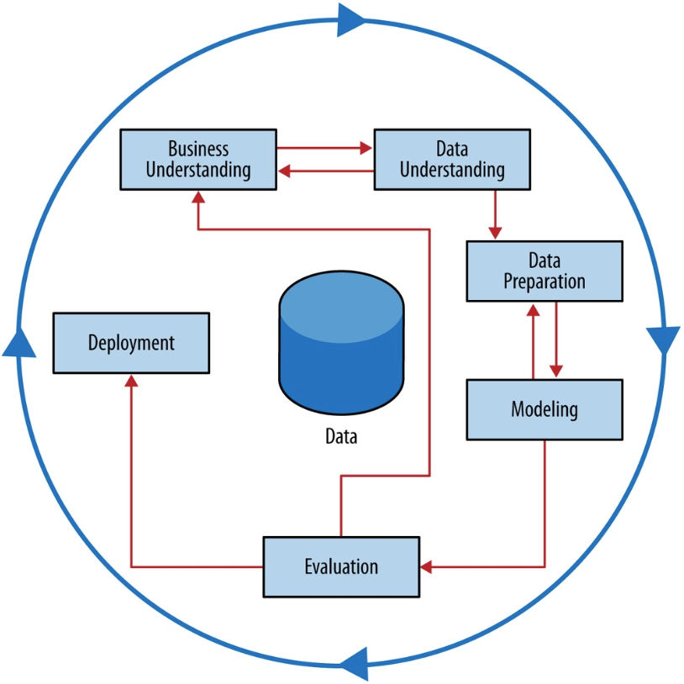
CRISP-DM
Data Science for Business, Foster Provost & Tom Fawcett
Notes:
Business Understanding
Understand the context and goals around the question(s) being posed. This is critical because in order to answer a question with any confidence you need to understand the question completely
Data Understanding
Statistical analysis
Sources and process.
Data Preparation
Deal with outliers
Missing Data
Unbalanced classes
Adjustments to account for bias or variance
Recoding
Modeling
Machine learning models
Evaluation
Iterative evaluation
Quantitative vs qualitative
Model
Accuracy
Interpretability
Evaluation against business requirements
Deployment
“Your model is not what the data scientists design, it’s what the engineers build”, Data Science for Business, Provost & Fawcett
Build a system around the model
Not necessarily a computer system!

Slide 12
Business Understanding
Fully define the question
Domain knowledge
Impact (organization, systems, external)
Responsible Assignment Matrix : Responsible, Accountable, Consulted, and Informed
Timing requirements
Accuracy requirements
Notes:
RACI is an acronym derived from the four key responsibilities most typically used: Responsible, Accountable, Consulted, and Informed.

Slide 13
Exploratory Data Analysis
What can the data tell us beyond the formal modeling or hypothesis testing task?
Statistical attributes
Balance of training labels
Source of data
Qualitative descriptions
How was the data processed up to this point?
Outliers
Missing data
Graphs
Notes:
Statistical attributes
How is the data distributed? Are the data independent?
Correlation
Mean, median, mode, variance, skew, max, min
Source of data
How was the data produced?
Qualitative descriptions
What do the fields mean? How do they relate to each other?
Box plot / violin plot
Scatter plot
Histogram
Correlation matrix
Heatmaps
QN-/QQ-plot

Slide 14
Data Terminology
Labels
Outputs
Dependent variables
Response variables
Targets
Columns (labels and features) are Attributes
Features
Inputs
Independent variables
Explanatory variables
Predictors
Observations
Examples
Instances
Records
Rows
Weight | Age (years) | Height | Sex | Country
171.5 | 20 | 5.8 | Male | USA
127.3 | 31 | 4.9 | Female | France
135.8 | 26 | 5.1 | Female | UK
162.1 | 47 | 5.9 | Male | China
Discrete variable
Categorical variables
Binary variable
Continuous variables
Example dataset, analyzing weight against other factors

Slide 15
Data Preparation
Center
Shift values so the mean becomes zero
Normalize
Scale data so it all lies between zero and one
Standardize (z-score)
Center and scale to a standard deviation of 1
Encode
One-hot, ordinal, label, other
Missing values
Remove records vs impute values
Feature selection or elimination

Slide 16
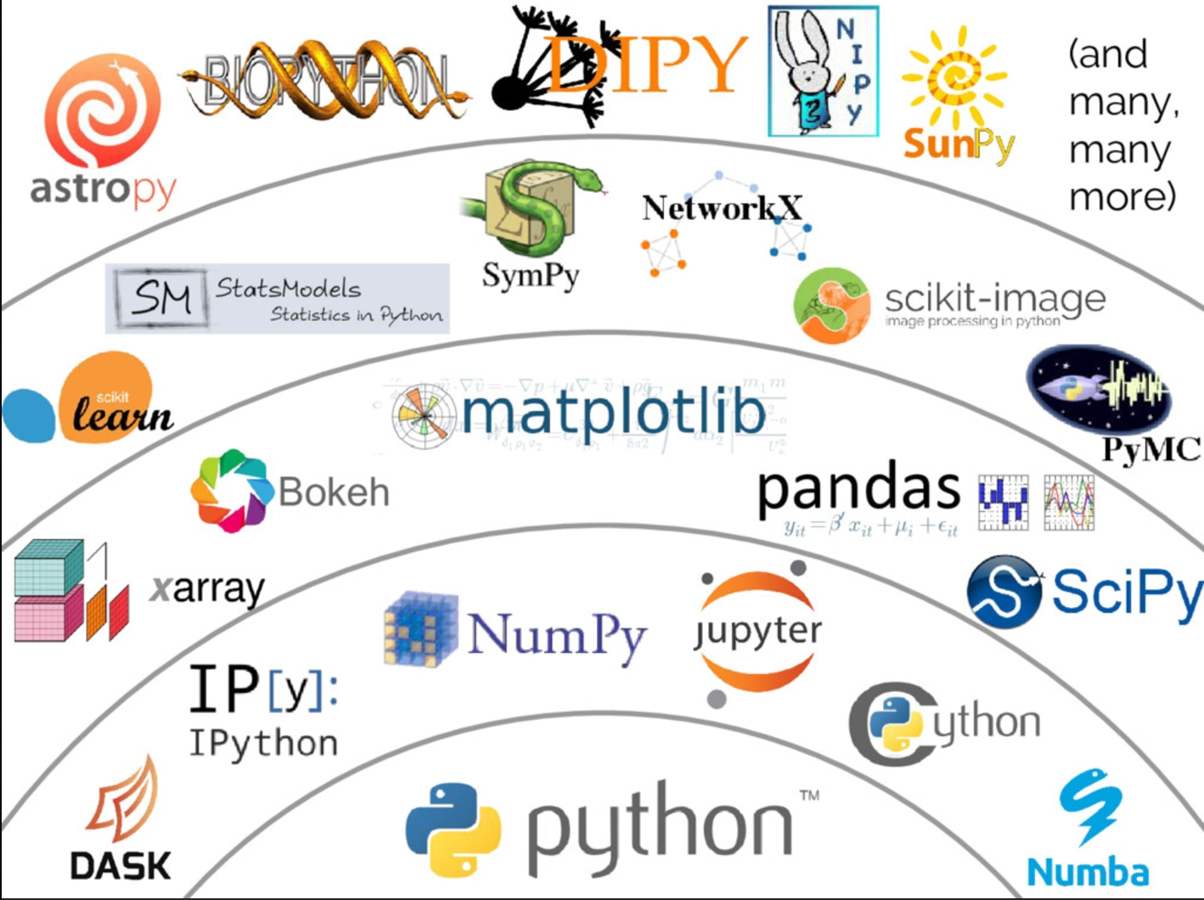
Python Intro
Notes:
Python is a popular programming language. It was created by Guido van Rossum, and released in 1991.
It is used for:
web development (server-side),
software development,
mathematics,
system scripting
Python is powerful... and fast; plays well with others; runs everywhere; is friendly & easy to learn; is open

Slide 17
Introducing Key Python Packages
A Python package is a collection of functions and methods that allows you to perform many actions without writing your code.
Key packages we are using : Numpy, Matplotlib, Pandas, Seaborn, sklearn
Importing libraries in Python
import numpy as np
Import pandas as pd

Slide 18
Numpy
- general-purpose array-processing
- provides a high-performance multidimensional array object
-tools for working with these arrays.
- contains various features :
A powerful N-dimensional array object
Sophisticated (broadcasting) functions
Tools for integrating C/C++ code
Useful linear algebra, Fourier transform
efficient multi-dimensional container of generic data

Slide 19
Pandas
-delivers a fast and efficient
DataFrame object -enables us to carry out entire data analysis workflow in Python
Pandas is used for :
reading and writing data
slicing, fancy indexing, and sub setting
size mutability;
merging and joining of data sets;
Time series-functionality
Highly optimized for performance
Notes:
Tools for reading and writing data between in-memory data structures and different formats: CSV and text files, Microsoft Excel, SQL databases, and the fast HDF5 format;
Intelligent label-based slicing, fancy indexing, and subsetting of large data sets;
Columns can be inserted and deleted from data structures for size mutability;
Aggregating or transforming data with a powerful group by engine allowing split-apply-combine operations on data sets;
High performance merging and joining of data sets;
Time series-functionality: date range generation and frequency conversion, moving window statistics, moving window linear regressions, date shifting and lagging. Even create domain-specific time offsets and join time series without losing data;
Highly optimized for performance
Python with Pandas is in use in a wide variety of academic and commercial domains, including Finance, Neuroscience, Economics, Statistics, Advertising, Web Analytics, and more.
Pandas does not implement significant modeling functionality outside of linear and panel regression; for this, look to statsmodels and scikit-learn.

Slide 20
Matplotlib
multi-platform data visualization library
allows us visual access to huge amounts of data in easily digestible visuals.
consists of several plots like line, bar, scatter, histogram
Using one-liners to generate basic plots in matplotlib is fairly simple, but
skillfully commanding the remaining 98% of the library can be daunting.
Notes:
Matplotlib is a visualization library in Python for 2D plotting.
Matplotlib is a multi-platform data visualization library built on NumPy arrays and designed to work with the broader SciPy stack. It was introduced by John Hunter in the year 2002.
One of the greatest benefits of visualization is that it allows us visual access to huge amounts of data in easily digestible visuals. Matplotlib consists of several plots like line, bar, scatter, histogram etc.
Matplotlib is also a massive library, and getting a plot to look just right is often achieved through trial and error. Using one-liners to generate basic plots in matplotlib is fairly simple, but skillfully commanding the remaining 98% of the library can be daunting.
This article is a beginner-to-intermediate-level walkthrough on matplotlib that mixes theory with examples
https://realpython.com/python-matplotlib-guide/

Slide 21
Seaborn
provides a high-level interface for drawing attractive and informative statistical graphics.
built on top of matplotlib and closely integrated with pandas
Options for visualizing univariate or bivariate distributions
Convenient views onto the overall structure of complex datasets
Tools for choosing color palettes that faithfully reveal patterns in your data

Slide 22

Scikit-learn

Slide 23
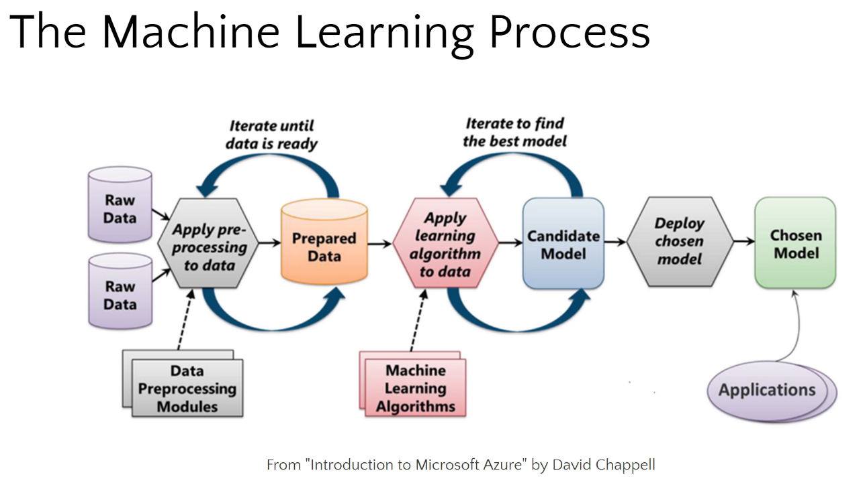
Modeling and Evaluation
Notes:
Challenges are Model Selection, Hyperparameter Tuning.
Getting learning rate right, regularization.

Slide 24
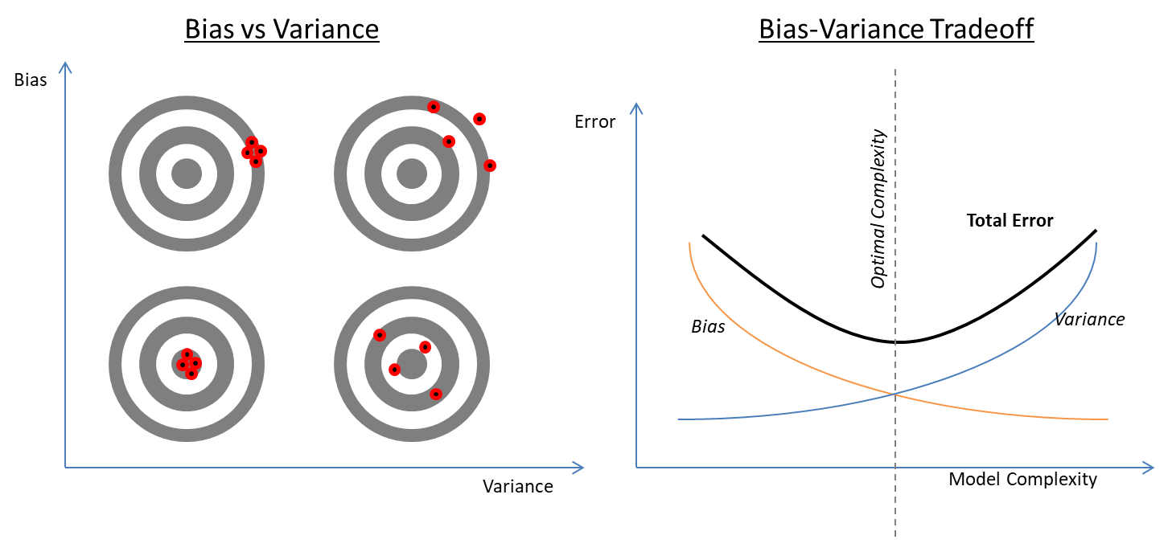
Bias/Variance

Slide 25
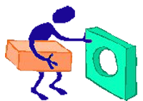
Overfitting and Regularization
Training data
New data
Overfit
Overfitting
If your model learns the training data too well it will not be able to recognize new data that looks in any way different from the data it learned on
Complex and/or flexible models are prone to overfitting
Where there are many features and few observations, overfitting is likely
Regularization
Weakens the predictive power of the model on the training set in order to generalize and prevent overfitting.
Techniques will depend on the model being used
Regularized
Notes:
“When all you’ve got is a hammer everything looks like a nail!” could be considered an example of overfitting.
Cellphone voice and fingerprint recognition, why record multiple times? – Generalization!

Slide 26
Loss
A loss function is a measurement of the difference between the true outputs and modeled outputs, for the same inputs
For many ML problems our goal is to minimize the loss between our model and the data
Common loss functions
RMSE, absolute error, zero-one error, log loss, R², K-L divergence, percentage errors, logarithmic error, ROC AuC, …

Slide 27
Deployment
 | Pre-deployment | Deployment
Role | Data scientist | Data engineer
Skills priority | Statistics, probability, mathematics | Programming, computer science, networking
Possible/likely tools | Python, R, Matlab, notebooks, research papers, … | Spark, RabbitMQ, Kafka, …
Output | Proof of concept | Production system
Goals | Accuracy, statistical fit, mathematical robustness | Efficiency, scalability, maintainability, operational robustness

Slide 28
Some Mathematical Foundations
Machine learning relies heavily on the these
Linear Algebra
Calculus
Statistics
Probability
You can start work on machine learning a minimal knowledge of math but you will need math do it well.

Slide 29
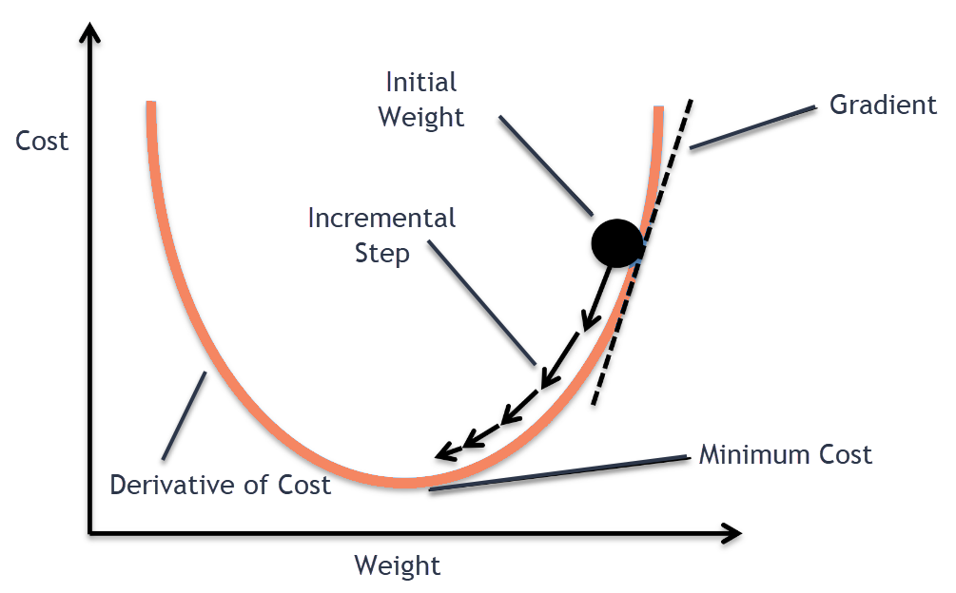
Gradient Descent

Slide 30
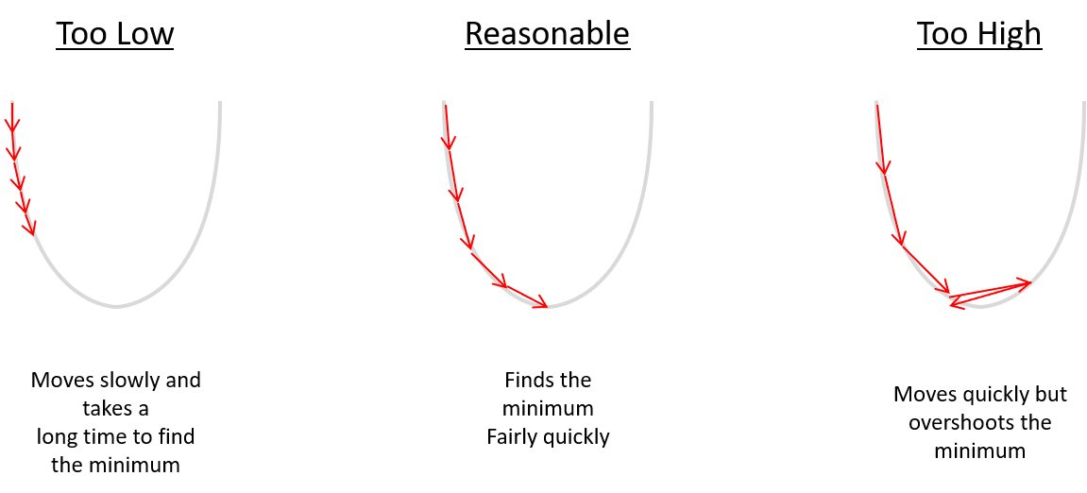
Learning Rate

Slide 31
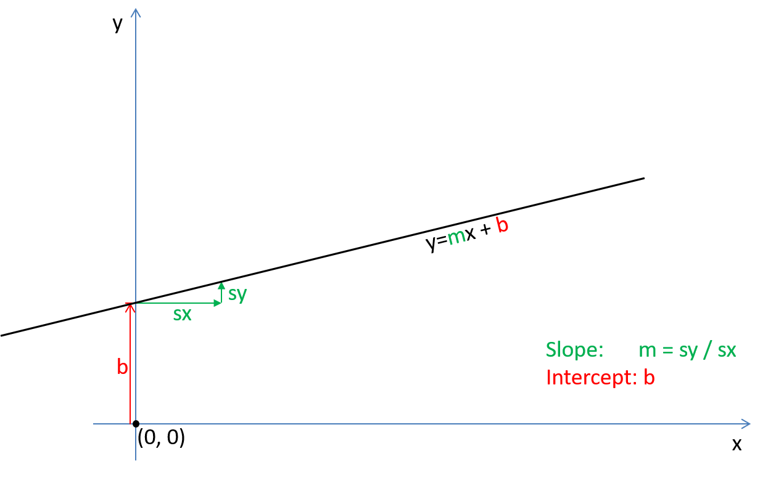
Slope-Intercept Form of a Line

Slide 32
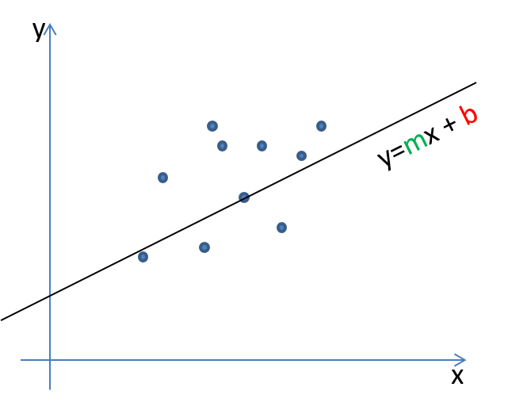
Regression
What slope (m) and intercept (b) will give us the best approximation to the data points shown?

Slide 33
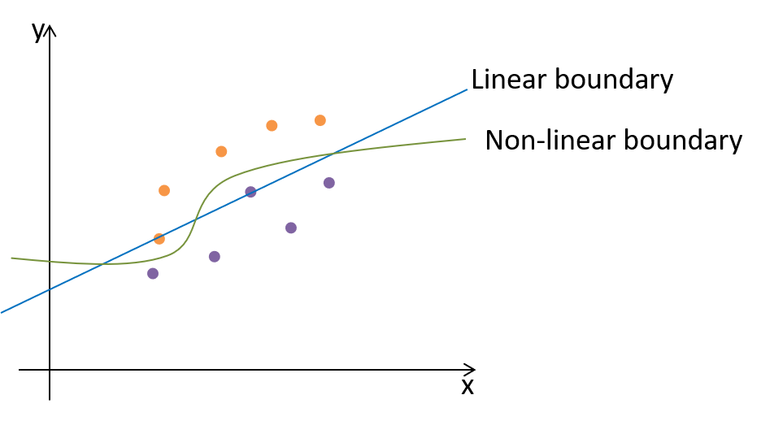
Logistic Regression - Linearity
We want to use a line to separate classes in order to keep the classification simple
but it would be nice to have some of the flexibility provided by non-linearity.

Slide 34
Classification
What slope (m) and intercept (b) will give us the best approximation to the data points shown?

Slide 35
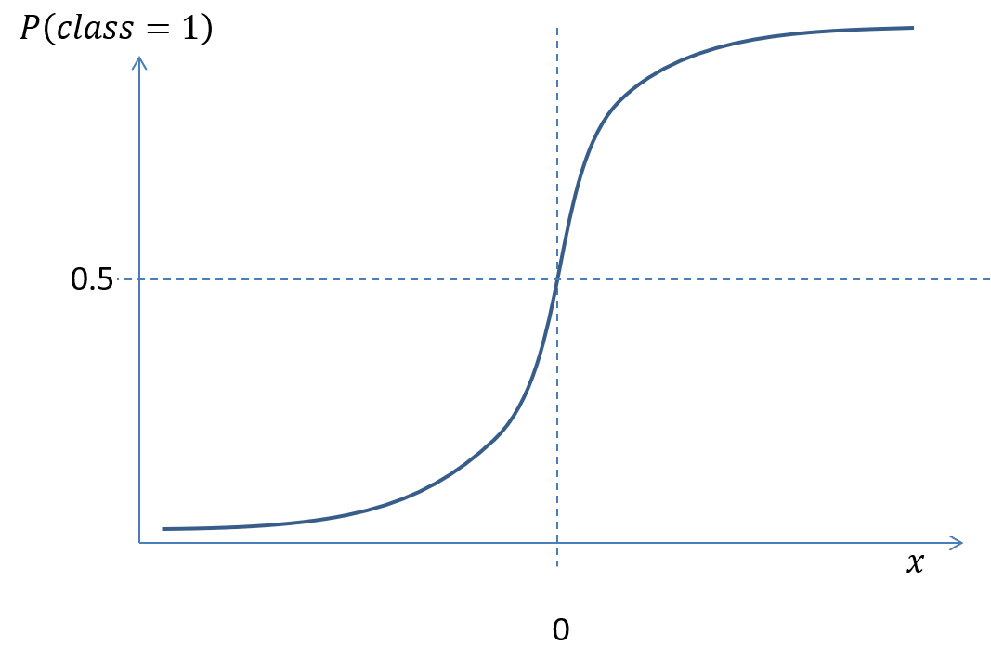
Logistic Regression - Sigmoid Function

Slide 36
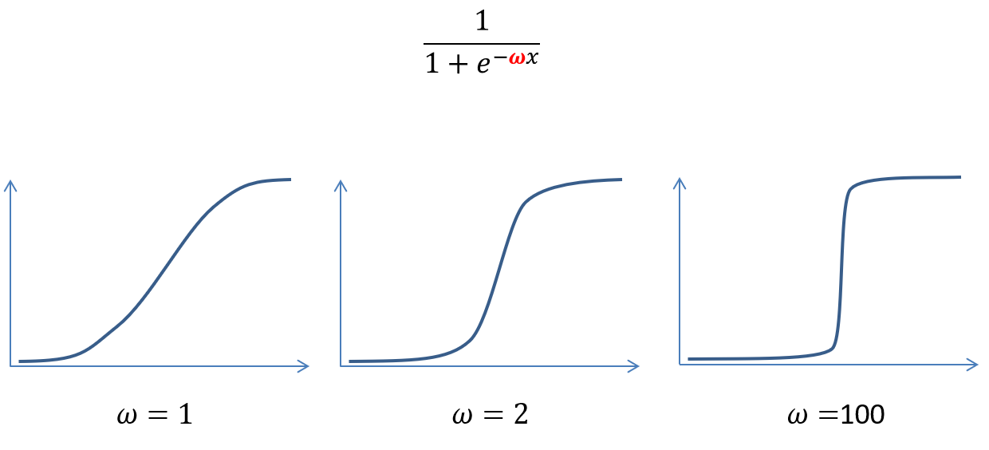
Effect of Logistic Function Weight

Slide 37
Logistic Regression – Sigmoid and Probability
Confidence of predicted labels
High
Low
y
y
x
x
Classes have very little overlap
Learned logistic weight is high
Probability (confidence) of class label becomes high quickly from the boundary line
Classes are heavily overlapped
Learned logistic weight is low
Probability of class is low even some distance from the boundary line

Slide 38
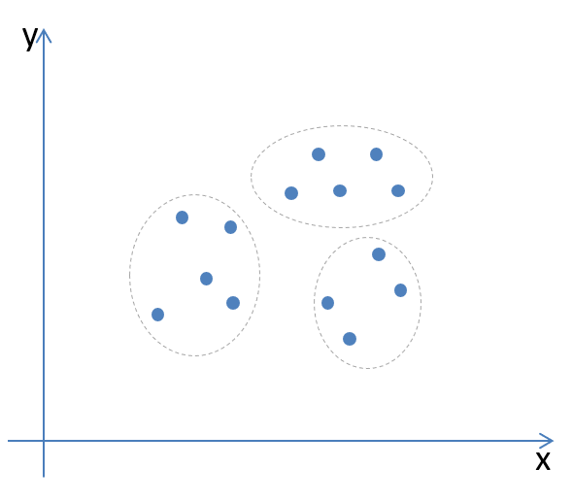
Clustering
Do our points form clusters (i.e. groups where points are close together)?

Slide 39
Clustering
An unsupervised technique that groups a set of objects in such a way that objects in the same group are more similar (in some sense) to each other than to those in other groups.
Useful for discovering patterns and information in data

Slide 40
K-Means Clustering
Pick k, the number of clusters
1
Set the initial cluster centers (means) randomly (or using another recommended method) within the data
2
Assign each observation to the closest cluster (mean or centroid)
Calculate the new mean (centroid) for each cluster
Repeat steps 1 and 2 until the assignments no longer change
3
Notes:
Suffers from the curse of dimensionality when there’s too many dimensions

Slide 41
K-Means Clustering
y
x
Centroids end up at the center of clusters of similar observations

Slide 42
Decision Trees
Can be applied to both regression and classification problems
Internal nodes: split the tree around a value of an attribute (e.g. weight <= 140lbs)
Leaf (terminal) nodes: mean response (label value) for observations falling there. (e.g. height = 5’0”)
Very easy to explain but lower predictive accuracy than other regression and classification methods

Slide 43
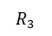
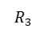
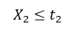
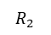
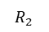
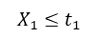
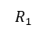
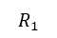
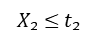
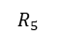
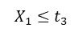
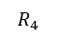
Decision Tree Pruning
$$X_{1}≤t_{1}$$
True
False
Example Tree:
Large trees will predict the training set well but are prone to overfitting.
A good strategy is to prune back a large tree
True
$$X_{2}≤t_{2}$$
False
$$X_{1}≤t_{3}$$
$$R_{1}$$
$$R_{2}$$
$$R_{3}$$
$$X_{2}≤t_{2}$$
$$R_{4}$$
$$R_{5}$$
$$X_{1}≤t_{1}$$
$$X_{2}≤t_{2}$$
$$R_{3}$$
$$R_{1}$$
$$R_{2}$$

Slide 44
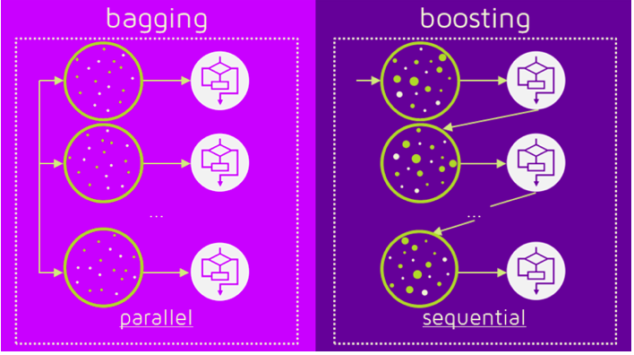
Ensembles: Bagging and Boosting
Ensemble learning - multiple models (often called “weak learners”) are trained to solve the same problem and combined to get better results.
Notes:
Ensemble learning is a machine learning paradigm where multiple models (often called “weak learners”) are trained to solve the same problem and combined to get better results. The main hypothesis is that when weak models are correctly combined we can obtain more accurate and/or robust models.
bagging, that often considers homogeneous weak learners, learns them independently from each other in parallel and combines them following some kind of deterministic averaging process
boosting, that often considers homogeneous weak learners, learns them sequentially in a very adaptative way (a base model depends on the previous ones) and combines them following a deterministic strategy
stacking, that often considers heterogeneous weak learners, learns them in parallel and combines them by training a meta-model to output a prediction based on the different weak models predictions

Slide 45
Ensemble Methods
Variance Reduction
Bagging (Bootstrap Aggregation)
Stacking
Bias Reduction
Boosting
Adaboost: Update weights on training set observations (best local optimizers)
Gradient Boosting: Update values on training set observations (best loss functions)
Random Forest
Sample over data and sample over features. Apply (deep) decision tree learners and average the results.
See https://towardsdatascience.com/ensemble-methods-bagging-boosting-and-stacking-c9214a10a205
Notes:
History – Statistical Resampling Methods
Jackknife (~1949, 1956)
Re-calculate the target statistic for the whole dataset again and again leaving one of the samples out in turn each run until all samples have been left out. Take the average of the results.
Bootstrap (1979)
Re-calculate the target statistic on groups that have been sampled with replacement from the dataset, many times. Take the average of the results.
Ensemble Methods
Variance Reduction
Bagging (Bootstrap Aggregation)
Weak learners (same type of models, maybe shallow trees) over bootstrapped samples then average or use a voting majority
Stacking
L weak learners (variety of models: e.g. KNN, SVM and logistic regression) over L folds (splits) of data
Bias Reduction
Boosting
Weak learners (same type model) applied sequentially and weighted according to how much they improve predictions
Adaboost: Update weights on training set observations (best local optimizers)
Gradient Boosting: Update values on training set observations (best loss functions)

Slide 46
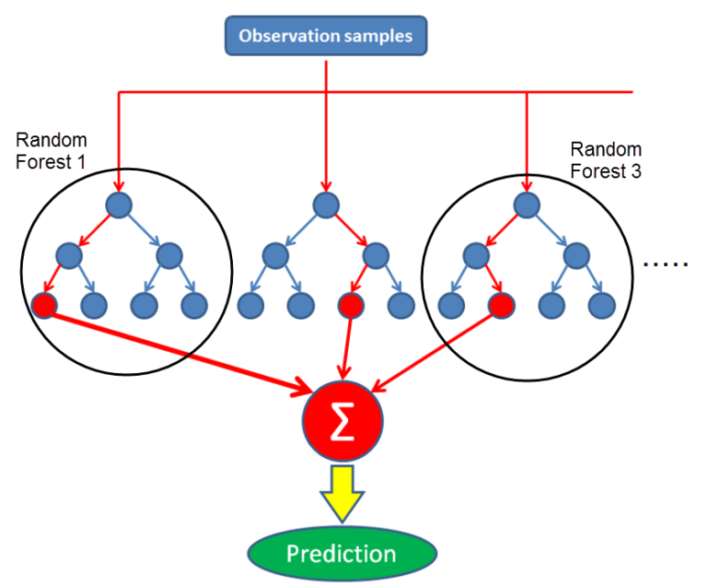
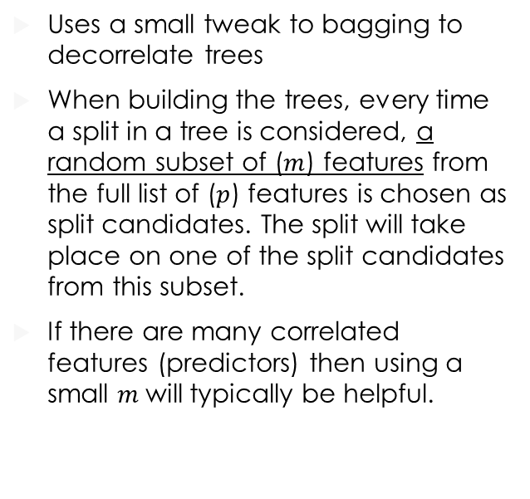
Random Forest
Uses a small tweak to bagging to decorrelate trees
When building the trees, every time a split in a tree is considered, a random subset of ($m$) features from the full list of ($p$) features is chosen as split candidates. The split will take place on one of the split candidates from this subset.
If there are many correlated features (predictors) then using a small $m$will typically be helpful.

Slide 47
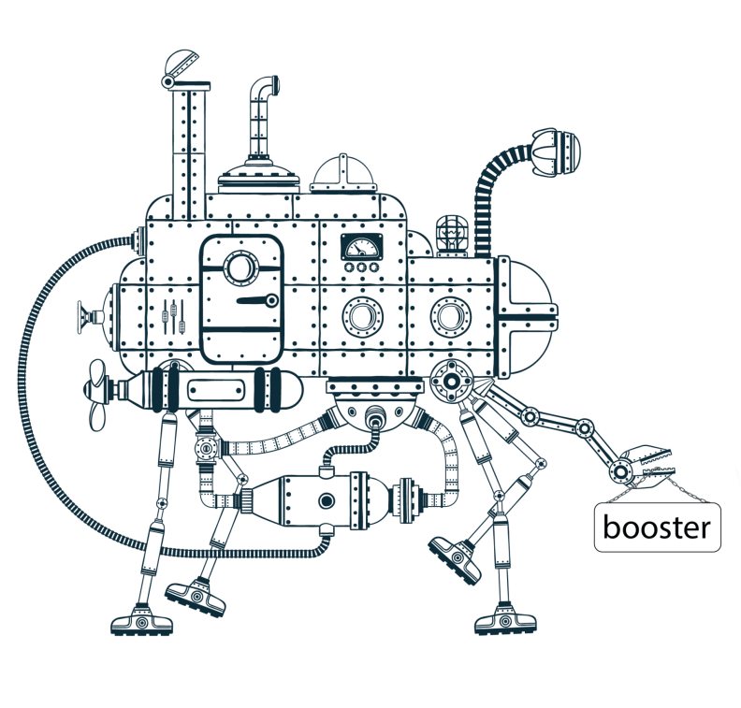
Gradient Boosting
Technique/family of algorithms which converts the weak learners to strong ones
Corrects the previous ensemble by adding predictors to the new ensemble
uses the error rate of the previous model to make the next one - reducing the error in the next model
Notes:
Minimizes the error in each run
Is a sequential technique that works on ensemble learning
Combines a set of weak learners and delivers improved prediction accuracy
Performance of the algorithm is iteratively improved

Slide 48
Dimensionality Reduction
Q: What do you do when you have too many features(dimensions)?
A: Reduce the number of features using:
feature elimination: remove features
or
feature extraction: combine features

Slide 49
Principal Component Analysis
x₃
x₃
PC1
PC1
PC2
x₂
x₂
t_{n}, the score value
x₁
x₁
Notes:
Lossy compression!
In the diagram above we’re projecting or data from a plane onto a line. The black line is chosen to give us the maximum average separation between points (minimizing information loss). The black line retains significantly more information than the red line but the red line contains only information not contained in the black line.

Slide 50
Principal Component Analysis
PCA is a feature extraction technique
The first principal component is the direction of the data along which observations vary the most. The second principal component will be perpendicular to the first.
When there are two features, at most two principal components can be identified. When dealing with many features the first few principal components will often capture much of the variation in the data.
PCA reduces interpretability because there is no explicit meaning to the principal components outside of their relationship to the data.

Slide 51
Support Vector Classifier
Classify observation depending on which side of a dividing hyperplane it lies
It is a soft margin classifier. That is to say, it can be violated by some observations. How much will depend on the parameters used
Approach:
Find a hyperplane that will maximize the margin subject to a tuning parameter which controls how many observations can be misclassified.
Observations that lie strictly (i.e. completely outside) on the correct side of the margin will not affect the classifier. All other observations are support vectors

Slide 52
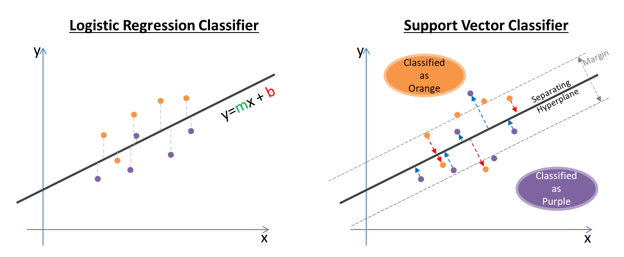
Support Vectors vs Logistic Regression

Slide 53
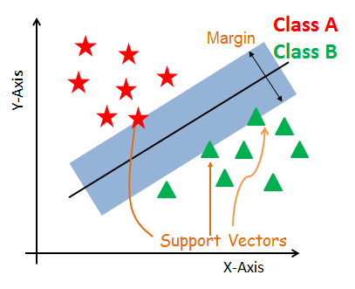
Support Vector Machines
It is based on the idea of finding a hyperplane that best divides a dataset into two classes
Applies a simple linear method to the data but in a high dimensional feature space to separate the data
Maximize the margin between the closest point to the hyperplane
Notes:
SVM is a frontier which best segregates the two classes. Say you want to classify a picture – if it’s a dog or a cat, based on some features – probably tail, ear geometry or snout length. Those data points are known as Support Vectors. We have D+ and D-, shortest positive and negative distance. D+ and D- make the margin of the plane. The line or the decision boundary is commonly referred to as Hyperplane. LSVM Linear SVM can do linear data. What if the data is non linear? So it could be multidimensional and it is computationally expensive. We can use the Kernel trick. There are different type of Kernels – Linear, Poylnomial and RBF Kernel. Parameter tuning can be done using K-Fold cross validation.
Adv: Effective in high dimensional space.
Dis: If # of features is higher than samples, a short matrix, then it can dilute the performance. SVMS do not provide probability estimates.
Application: Used for Time Series Analysis in Financial Industry, Fault detection of Machines, Page Ranking by Google Search

Slide 54
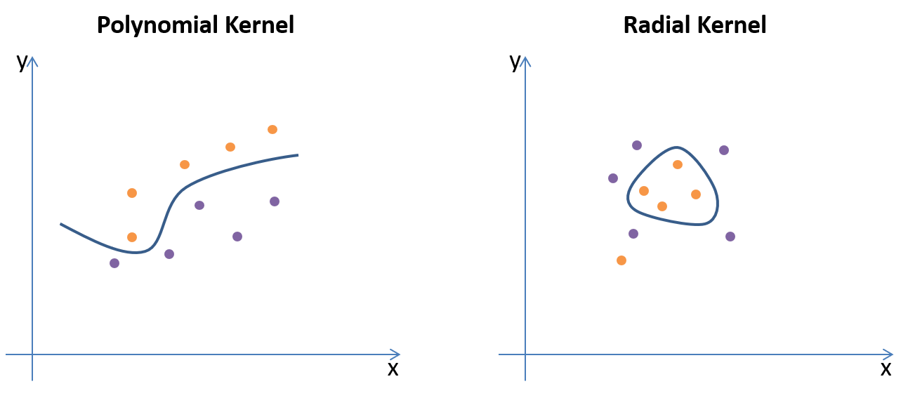
Support Vector Machines

Slide 55
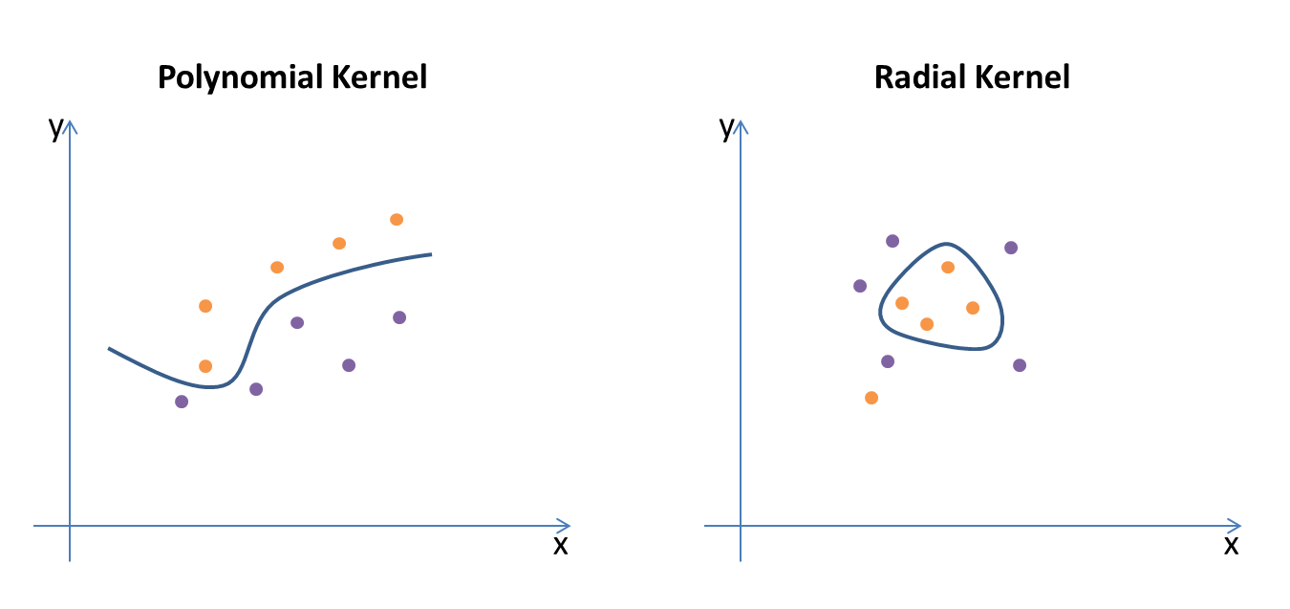
Non-Linear Support Vector Machines

Slide 56
Great Resources
Books
Introduction to Statistical Learning, James, Witten, Hastie and Tibshirani (free download available)
Data Science for Business, Foster Provost and Tom Fawcett
Machine Learning with Python Cookbook, Chris Albon
Introduction to Machine Learning with Python, Sarah Guido and Andreas Müller
Fundamentals of Machine Learning for Predictive Data Analytics, John Kelleher, Brian Mac Namee, Aoife D’Arcy
Python Data Science Handbook, Jake VanderPlas
Hands-On Machine Learning with Scikit-Learn and TensorFlow, Aurélien Géron
Free Online Courses
Machine Learning (Matlab/GNU Octave), Coursera, Andrew Ng
Intro to Machine Learning (Python and scikit learn), Udacity, Katie Malone and Sebastian Thrun
Statistical Learning (R), Stanford, Trevor Hastie and Rob Tibshirani
Note: Ng’s course uses Matlab/Octave and Hastie and Tibshirani use the R language

